Slide 1
Griffith Buck Rose Website
Client: Reiman Gardens, Lindsey Smith
Advisor Mai Zheng
sdmay24-41
By Patrick Origer, Logan Schmit, Amy Hartjen, Alex Reynolds, Erik Sandberg, Greg Carter and Devin Amdahl

Slide 2
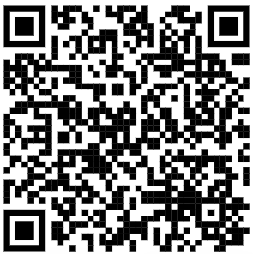
Introduction
Project: Informative website on the unique roses created by Dr. Griffith Buck which are stored at Reiman Gardens
Objective:
Informative: Basic rose info, Griffith Buck and Reiman Gardens
Maintainable: The website shall allow Reiman Garden employees to edit the website’s information via simple forms
Mobile: The website needs to be structured for mobile applications
Overall: Create a website to make the general public more aware and informed of the Griffith Buck roses in a highly readable way
http://griffithbuck.ece.iastate.edu:3000/Home

Slide 3
Users
Who: Rose cultivators and Buck Rose enthusiasts Elderly Average user needs highly intuitive and user friendly website Uses: Information gathering for specific roses Filter/search Plant Care Rose bloom Pest Appearance | Why: Dr. Griffith Bucks famous research into plant hardiness and disease-resistance Over 60 industry sources including nurseries in the US, Canada, England, New Zealand, Denmark, Norway, and India Context: Global Impact: The public will be able to learn about the roses as well as get help with cultivation and maintenance Economic Impact: Marketing for Reiman Gardens and Buck Rose vendors

Slide 4
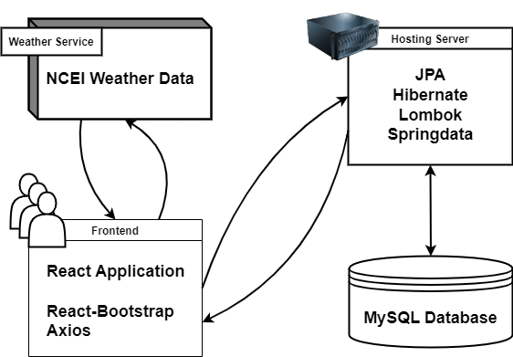
Project Overview
Project Management: Github Discord Design Tools: Figma LucidChart Draw.io Frontend Stack: React.js Axios Bootstrap | Database: MySQL Flower Information Page Information Vendor statuses Backend Stack: Docker MySQL JPA Spring/Boot Hibernate Lombok Spring Data
Notes:
Engineering Problem Solving

Slide 5
Major Components
Homepage
Individual Rose Pages
Mobile Version
Admin Pages
Degree Day Calculator
Notes:
Engineering Problem Solving
The project starts with the Homepage for : displaying the roster of overall flowers for guests to navigate around Individual rose pages for : displaying the information that rieman garden’s and our client wanted to be featured for each flower
Mobile version for : mobile navigation of the website
Admin pages for : the client to manage the displayed information on each of the other pages of the site Degree day calculator for : requested by our client, is for tracking the predicted dates of pest emergence for anyone cultivating buck roses

Slide 6
Homepage
Fluid Key Dynamically filters flowers based on any combination of there dozens of characteristics. Integrates with pagination Inclusive or exclusive filtering | Fact/Rose of the Day Based on local time zone Pulls random flower/fact and display on carousel Info Pages About Us, Griffith Buck, Glossary Dynamic Display Navigation of different section via banner buttons
Notes:
Engineering Problem Solving

Slide 7
Individual Rose Pages
General Information: Cultivation year, color, name, description, height, parentage, descendants, location, hardiness, notes, and disease resistance Bloom Tracker: Shows week that individual flowers bloom | Vendors: Includes vendor pricing, last updated, name and website link Dynamically displays any amount of vendors Dynamic Routing: Unique dynamically created link for each flower More shareable
Notes:
Engineering Problem Solving

Slide 8
Admin Page
Login: Admin pages hidden from general user Admin users can log in with username & password Navigation: Landing page lists all tables Information about each table on the admin home page | Updating: Admin page loads specific database table Admin user can select row they want, then they can edit the information in dynamically made forms Admin User can send edited row as an update, addition or deletion into that table
Notes:
Engineering Problem Solving

Slide 9
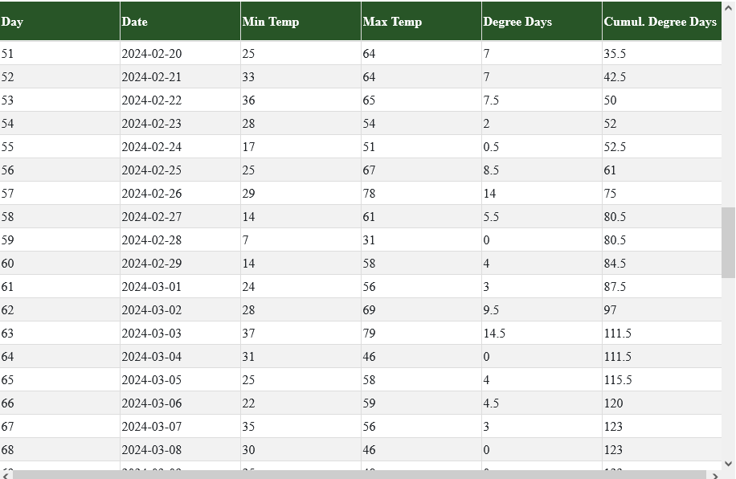
Degree Day Calculator
Quick Overview: Tracking when pests become threats to Buck Roses Calculates based on weather data from stations across Iowa Calculation methods: Average, Modified Average/Custom, Sine | Input/Output Briefing: Inputs: Station, Date Range, Daily Temps, Temp Bounds Output table:
Notes:
Engineering Problem Solving

Slide 10
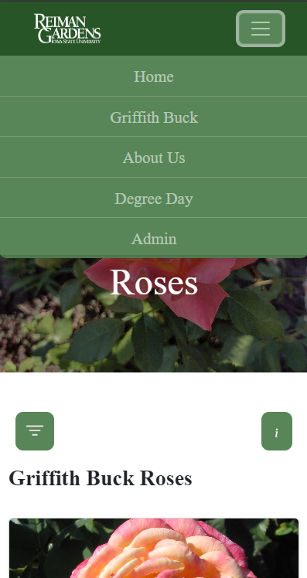
Mobile Version
Mobile Version Implementation: CSS media queries Bootstrap Breakpoints, grid system, etc. Dynamic sizing Separate implementation for navbar and footer Horizontal scrolling for some features
Notes:
Mobile Version
Creating a mobile version of our website that is consistent with our desktop design ended up being a lot simpler than we initially thought thanks to CSS media queries, Bootstrap breakpoints, and Bootstrap’s grid system.
Much of our desktop design already utilized dynamic sizing to ensure a consistent look across devices of varying resolutions, so it was easy to leverage this in our mobile design.
The most notable differences between our desktop and mobile design are the website’s navbar and footer which required their own implementations for mobile.
Despite this, our website contains some features that do not easily map to mobile displays such as the admin, degree day, and bloom week tables. For these features, we decided the best solution was horizontal scrolling.

Slide 11
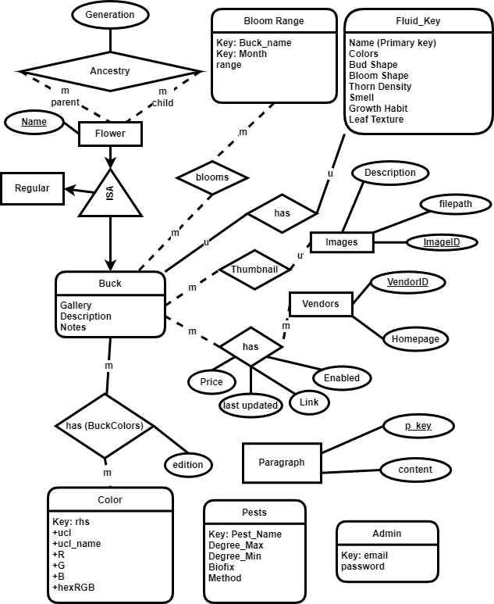
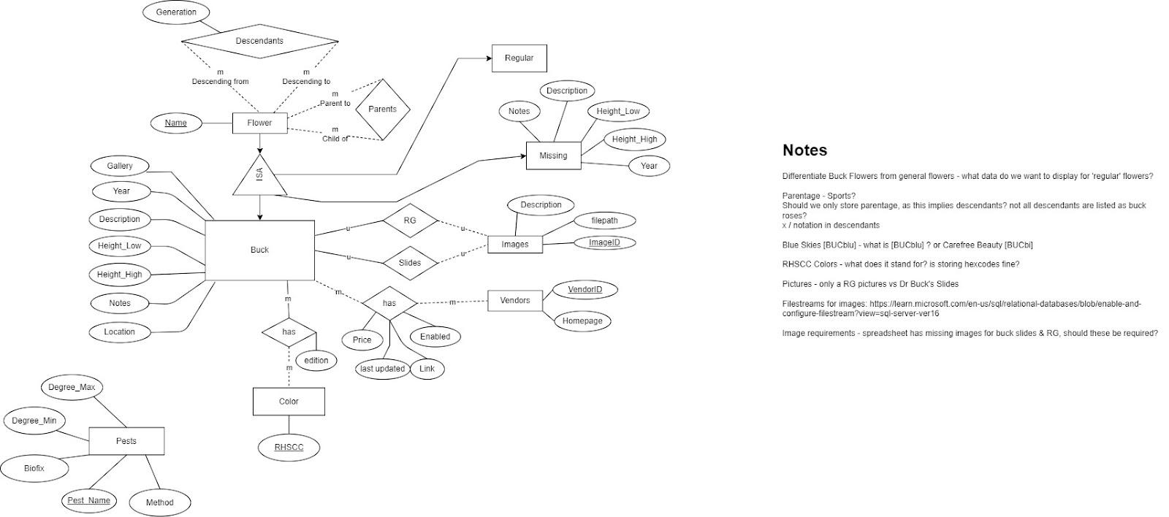
Database Design
 | Design Choices MySQL Feedback: Graph Database Design Changes Remove ‘missing’ flowers table Bloom days table addition Admin authentication table Fluid Key attributes expanded Paragraph information in database vs hardcoded Change thumbnails relationship Merge parents & descendants table into ‘Ancestry’
Notes:
Engineering Problem Solving

Slide 12
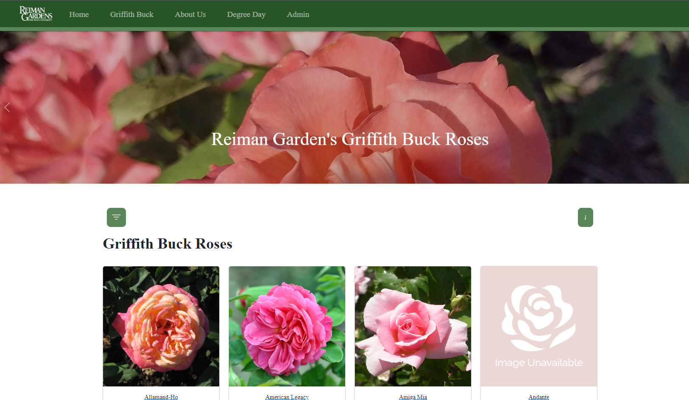
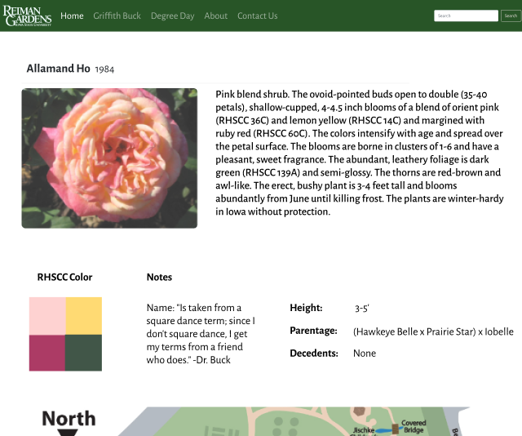
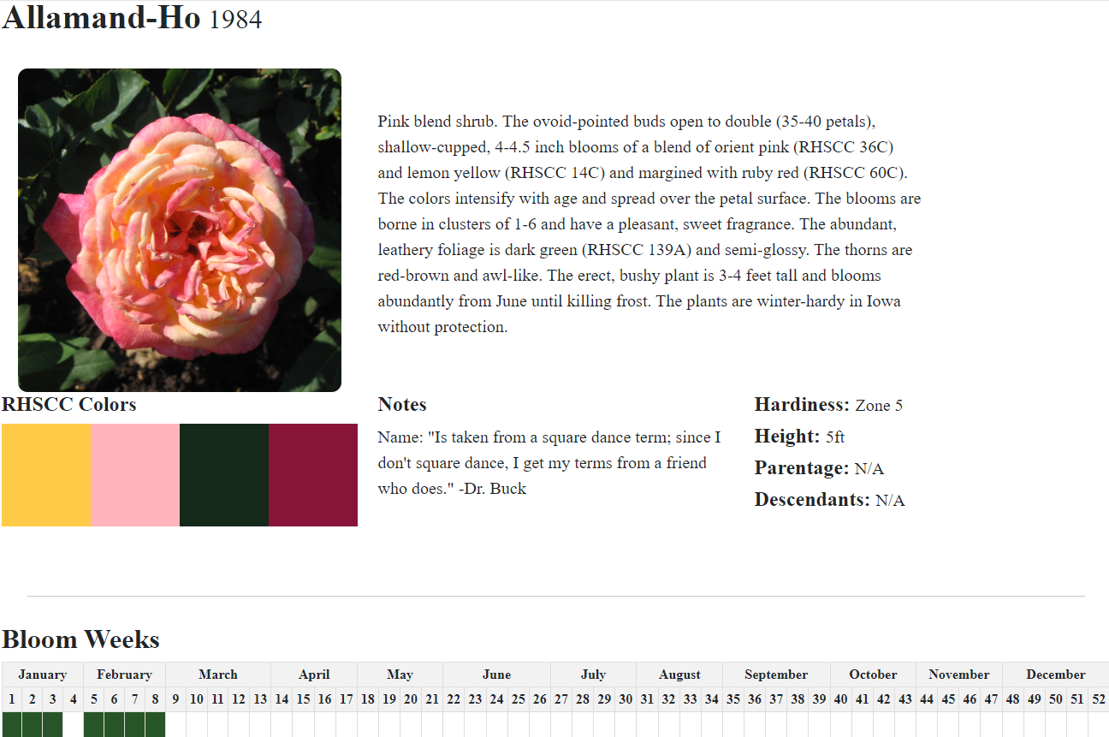
Frontend Design
 | Fluid Key is collapsible Footer has contact us information Glossary Page Removed global search feature Removed dynamic map Bloom days separate from degree days
Notes:
Engineering Problem Solving

Slide 13
Challenges
Data: Frequent database/schema changes Data retrieval Flower photos in the fall Reiman Gardens map Disease resistance Bloom ranges Fluid Key attributes Pests | Security: Originally using Okta ITS switching from Okta to Azure Implementing authentication and session management ourselves Other: Degree Day/weather API Server storage of images Dynamic vendor information Larger group Double-edged sword
Notes:
Challenges
For our first challenge, the design of our database/schema changed relatively frequently throughout the semester. This was mainly caused by new requirements from our client and discovering limitations in our original design.
For our second challenge, it was common for us to find ourselves planning and designing around data that we didn’t have access to. Since Dr. Griffith Buck created these roses many years ago, there was a lot of information that our client needed to assemble or receive from Dr. Griffith Buck’s daughter. And given the cold of Iowa’s winters, there was a lot of data that couldn’t be collected until the weather permitted, such as photos and bloom ranges.
For our third challenge, we had hoped to integrate our admin authentication with Iowa State’s Okta. This would have allowed us to leverage existing infrastructure and create a more seamless experience for the website’s admins. However, ITS informed us that at some point in the near future ITS will be abandoning Okta for Azure, which would leave our website relying on a system that no longer exists. Along with this, the integration would have required an extended review and security audit of our application, and we were afraid of banking on something that was not guaranteed, especially when the process could take several weeks.
And for some of our miscellaneous challenges:
It took a while to find a weather API that would provide us with the necessary data to calculate degree days at a low-cost or for free.
We struggled to determine the most appropriate way of storing our images in manner that allowed them to be changed at the admins’ discretion while maintaining the portability of our application and allowing the image storage to tolerant to changes in how the application is hosted. At this point in time, we are leaning towards leveraging Amazon S3 before handing the application over to our client.
Initially our client wanted a way to dynamically retrieve information about the availability of certain Buck roses from rose vendors, such as the current price, quantities, and availability. However, we were unable to determine a way to implement this without utilizing vendor-specific web scraping.
Our final challenge came from our group’s large size. While there are several benefits to this, such as having a more diverse collection of prior experience, knowledge, and ideas, and having more people to complete work, this also required a greater amount of communication, planning, and agreed-upon conventions or standards.

Slide 14
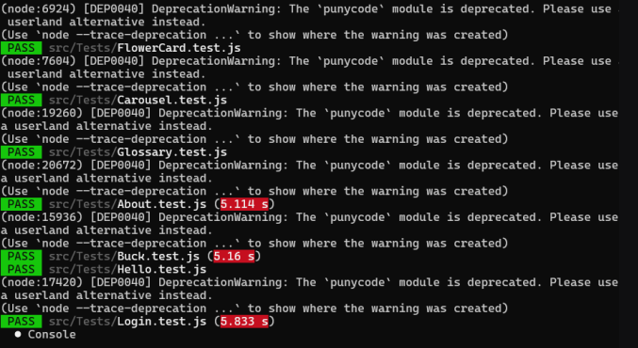
Testing
Libraries: JUnit Serenity Mockito React’s Testing Library Types: Unit System Acceptance Beta Testing since April 7th | Process: Tests run in Build and Pipeline Manual testing to ensure functionality Reviews and Approvals before merges
Notes:
Engineering Problem Solving
The frontend was tested using ReactDOM, simulating and rendering the frontend and then verifying that different aspects properly were displayed. As well, the backend was tested using Mockito and JUnit to mock the repository and then perform service layer tests with dummy data and determining if the output matched what was expected. We found the most useful testing to be done manually but the test files we wrote were helpful in ensuring random parts weren’t breaking during development.

Slide 15
Conclusions
Progress: We were able to complete the original goal of building an easily maintainable website for Reiman Gardens Management of website requires little to no code knowledge Mobile design is fully implemented Advanced degree day calculator to replace Michigan State University’s Information displayed can help cultivators by given them pesticide times and bloom ranges | Value: Provides open, easy access to information about Griffith Buck Roses and Reiman Gardens Future Client Goal: CSV Upload Better Image Storage Solution Dynamic Linking Cloud Architecture
Notes:
Engineering Problem Solving

Slide 16
Questions?

Slide 17
Thank You!
https://sdmay24-41.sd.ece.iastate.edu

Slide 18
Who are We?
Amy Hartjen - Client Interaction, Organization, Frontend Design
Erik Sandberg - Full-Stack, Database Administrator
Devin Amdahl - DevOps, Scrum Master, Full-Stack
Patrick Origer - Research, Third Party Manager, Degree Days
Alex Reynolds - Frontend Lead
Greg Carter - Full-Stack, Connections, Backend
Logan Schmit - Backend Helper, Lead Testing
Notes:
Professional responsibility

